Slide 1
Fuel (Battery) Range Monitoring and Gas (Charging) Station Referral
Dan Linnen

Slide 2
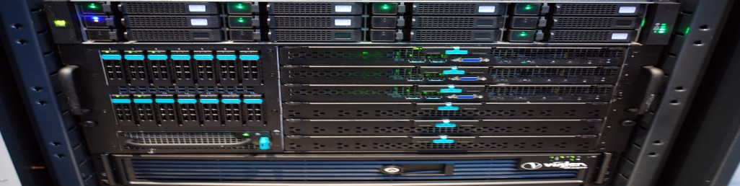
Disclaimer
The project is for a class and falls under the restrictions of what a t2.micro is capable of, which limits it to one virtual Xeon core, 1 GB of memory and limited file storage.
This does not allow for the overhead required to maintain a gas/charging station database.
This does not allow for a street map database.
Recommending specific stations is out of the scope of this class project based on the previous 2 limitations.
This project is targeted for use of Spark Streaming to demonstrate a competency using such a system.
Spark Streaming limits the user to a small time window and thus a limited number of samples.
It will not allow for long term data analysis and thus limits the scope of this project to analyzing and using data in a limited window and volume.
These limitations push toward filtering/sorting algorithms as they work well on small sets of data.

Slide 3
Project Summary
Modern cars often indicate the distance that can be traveled based on the available gasoline in the tank. Many such cars are now connected to the internet or connect to devices that connect to the internet.
The cars or the devices could be capable of running software/apps that could monitor the cars position (GPS), fuel level and fuel distance, which could be sent to the cloud.
Once in the cloud, this data could be used to recommend fuel/charging stations that are in range of the car based on the remaining fuel when the car is low on fuel.
For this project, Spark Streaming was used to analyze the data for a given threshold (binary low fuel) to signal that calculation is required. When calculation is required, the fuel range of the car would be compared to the distance between the car and fuel stations to make a recommendation. (This comparison/recommendation is outside of the scope of this project.)
Some potential markets could include: This sort of application could be valuable to fuel companies looking to direct more customers to their stations, to roadside assistance companies that are looking to increase their offerings and reduce their number of fuel-related service trips and to all-in-on charging and car providers that might want to increase their features offered to the customer.

Slide 4
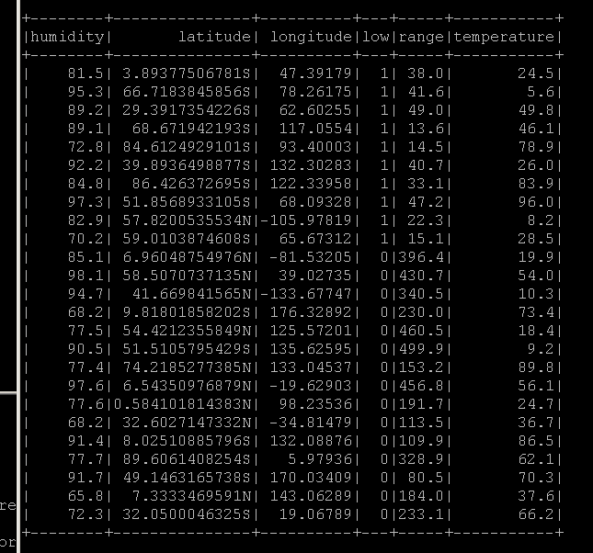
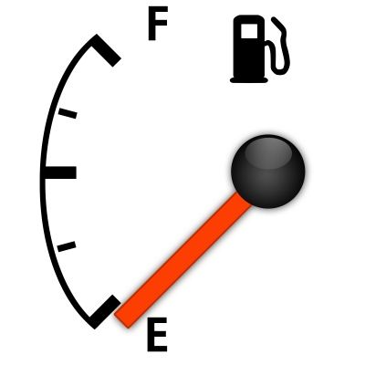
Sorted/Filtered Data
Good Data to act on!
(Although fuel/batter range is good to act on, these cars have decided that they are “low” on fuel, and so the user is likely considering their low fuel/batter range.)

Slide 5
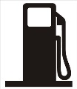
Action to Take
Consider the location.
Consider the range.
By considering these factors and finding a fueling station in range, a recommendation as to where the driver might be advised to go is a good plan.

Slide 6
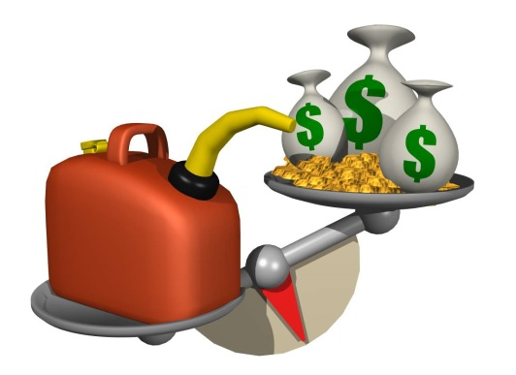
Specifics of the Action
A database of gas stations could be searched to determine ones within range.
Biased Approach:
Gas stations that support/sponsor the app/service could be highlighted first.
Non-Biased Approach:
All nearby stations could be recommended with an emphasis on factors like price and user reviews highlighted. (Roadside assistance model.)

Slide 7

What to do if there is no station in range?
It is very possible that there could be a situation where no fuel station is in range, is operating and capable of supplying the necessary fuel grade/type.
In such a scenario it may be appropriate to inform the user of the circumstance prior to fully draining the batteries or the tank, as neither is likely very good for the vehicle or the user.
Informing the user can let them know that help is on the way in the case of a road side assistance application. (If the environment outside is bad then it may be best for the user to conserve energy by not driving and to wait for assistance.)
Informing the user can change behavior, such as driving with air conditioning or speeding.
Consider dispatching help in the form of roadside assistance or placing an automated call to a local emergency dispatcher.

Slide 8
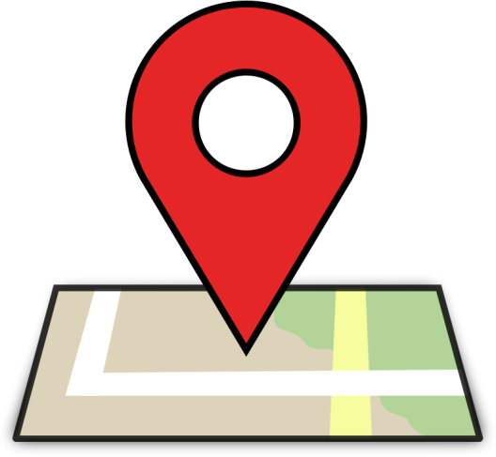
Bigger Data (and Longer Time)
It is quite conceivable that as this data builds up over time it could be archived and periodically analyzed to find ideal locations for new fuel/charging stations based on demand. (Many other things could be done with such data, but this one could be very profitable.)

